Slide 1
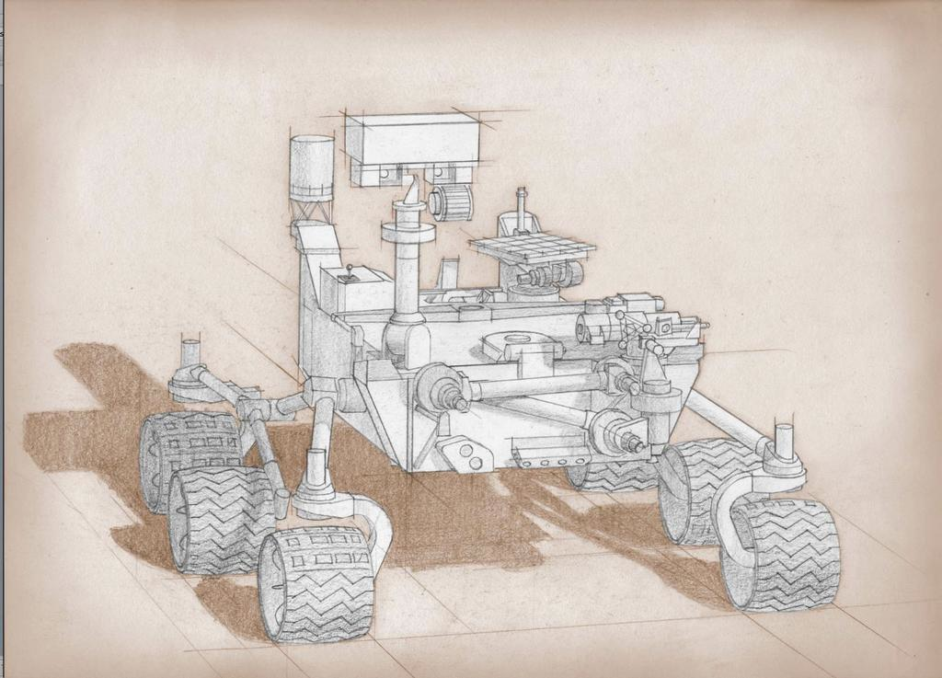
MARS 2020 MISSION UPDATE
Jet Propulsion Laboratory
California Institute of Technology
MARS 2020 Project
NOTE ADDED BY JPL WEBMASTER: This content has not been approved or adopted by, NASA, JPL, or the California Institute of Technology. This document is being made available for information purposes only, and any views and opinions expressed herein do not necessarily state or reflect those of NASA, JPL, or the California Institute of Technology.
Ken Farley, Project Scientist
Ken Williford, Deputy Project Scientist

Slide 2

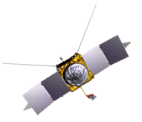
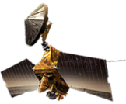



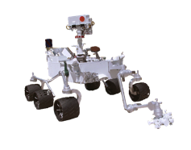
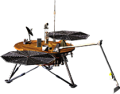
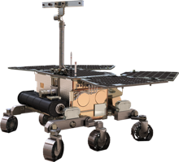
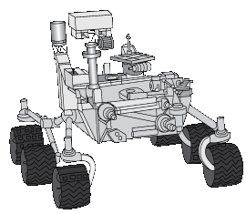
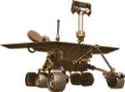
Current & Future Mars Missions
Operational
2016
2018
2020
2022
2001 - 2014
Mars Odyssey
Mars
Reconnaissance
Orbiter
ESA
Trace Gas Orbiter
(NASA: Electra)
ESA Mars Express
(NASA: MARSIS)
MAVEN
Opportunity –
Mars Exploration
Rover
Curiosity –
Mars Science Laboratory
ESA
ExoMars Rover
(NASA: MOMA)
Science Rover
InSight
Follow the Water
Explore Habitability
Seek Signs of Life
Prepare for Future Human Explorers
EVOLVING MARS SCIENCE THEMES

Slide 3
Mars 2020 Scientific Objectives
A. Geologic History
Carry out an integrated set of context, contact, and spatially-coordinated measurements to characterize the geology of the landing site
B. In Situ Astrobiology
Find and characterize ancient habitable environments, identify rocks with the highest chance of preserving signs of ancient Martian life if it were present, and within those environments, seek the signs of life
C. Sample Return
Place rigorously documented and selected samples in a returnable sample cache for possible future return to Earth
Jet Propulsion Laboratory
California Institute of Technology
MARS 2020 Project

Slide 4
Jet Propulsion Laboratory
California Institute of Technology
MARS 2020 Project
Mars 2020 Scientific Objectives (2)
Additional objectives:
A) facilitate future human exploration by demonstrating an in situ resource utilization technology
B) demonstrate additional technologies required for future Mars exploration
The Mars 2020 mission fulfills the high priority Decadal Survey objective to initiate the first step in the multi-mission campaign to (potentially) return carefully selected Martian samples to Earth

Slide 5
S
Jet Propulsion Laboratory
California Institute of Technology
MARS 2020 Project
Mars 2020 Mission Implementation
1) Scientific observations required to assess geologic history and astrobiology are
the same as the instruments required for selecting/documenting samples in the cache. We
are a single integrated science mission.
2) Overarching theme for Mars 2020 instruments: make both visual/textural and
mineralogical observations at a range of spatial scales from outcrop to sub-mm. Also need
elemental chemistry and detection of reduced carbon.

Slide 6
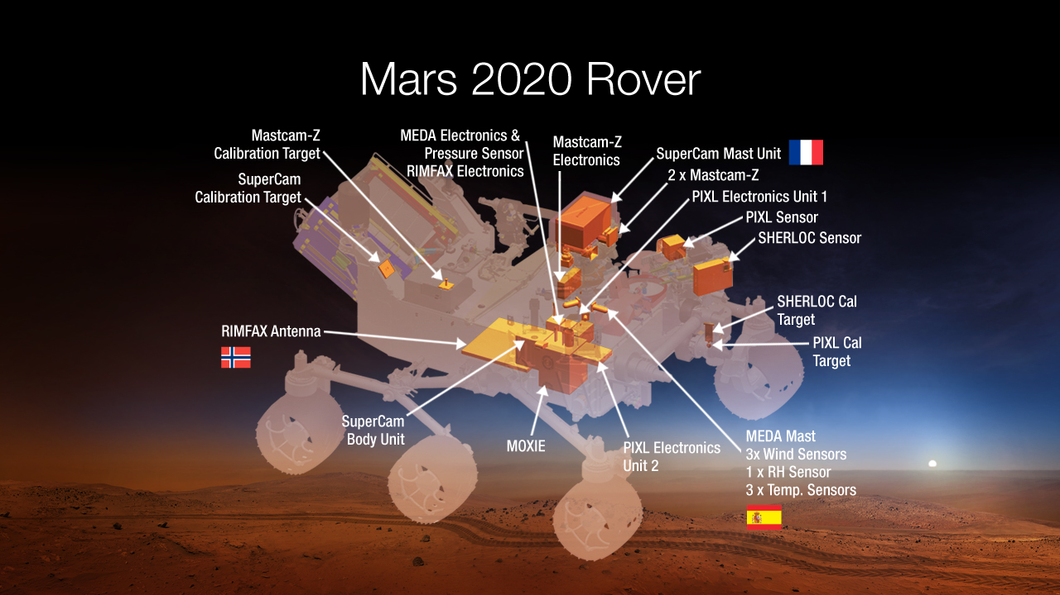

Slide 7
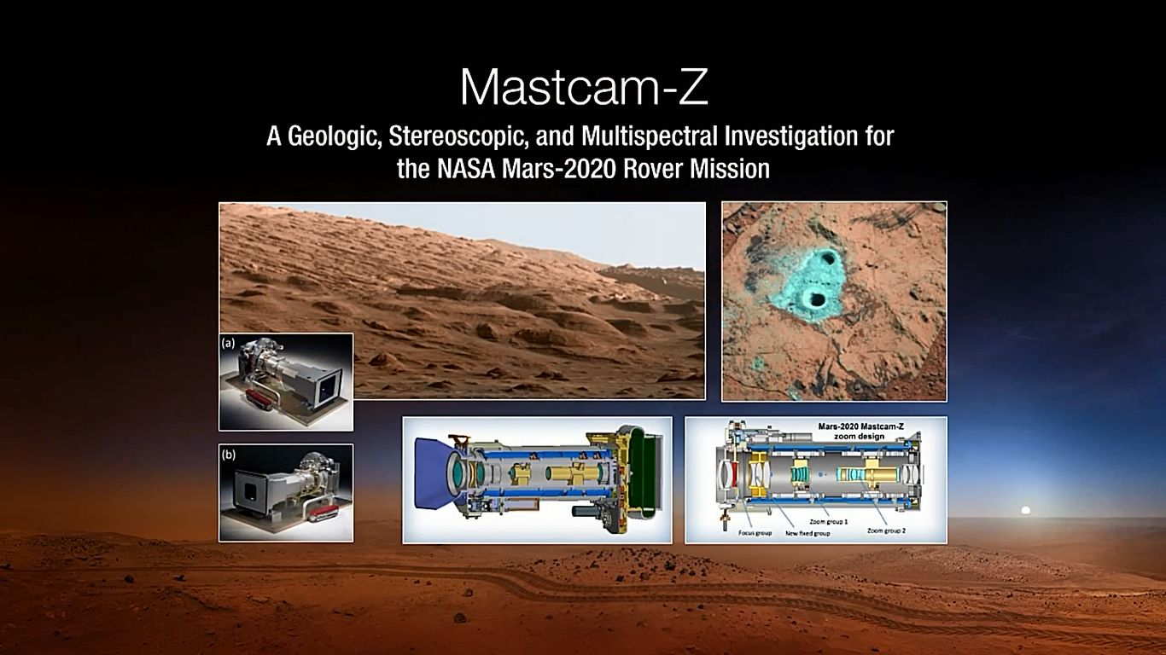
PI Jim Bell, ASU (with Malin Space Science Systems)
-improved stereo zoom camera with strong MSL heritage

Slide 8
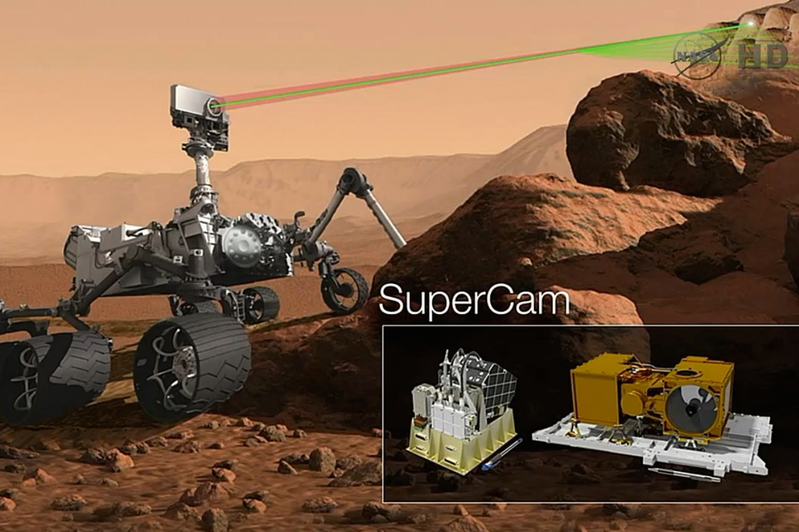
PI Roger Wiens, LANL, with major French and Spanish involvement
- advancement on MSL Chemcam – has laser induced breakdown spectroscopy (LIBS) +
remote Raman and fluorescence spectroscopy + visible and infrared spectroscopy +
remote micro-imaging (“telescope”). Goal is remote mineralogy and chemistry, including
organic detection.

Slide 9
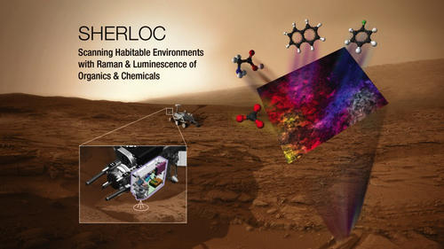
PI Luther Beegle, JPL
- laser induced fluorescence and Raman spectroscopy to identify minerals
and organic molecules, highly spatially resolved (~50 um scale)

Slide 10
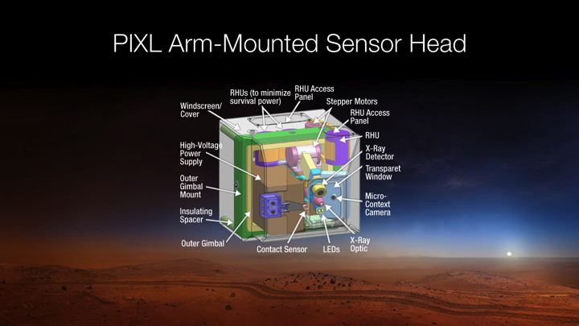
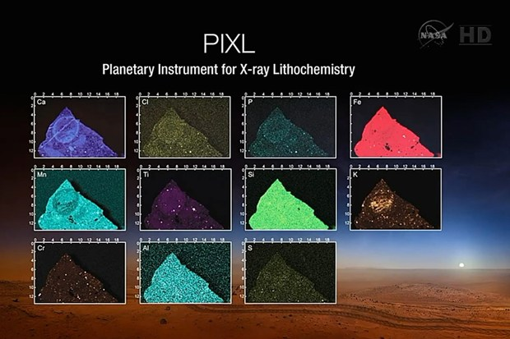
Planetary Experiment for
X-Ray Lithochemistry
PI Abigail Allwood, JPL
- x-ray fluorescence technique to measure rock chemical composition at the ~100 um scale.

Slide 11
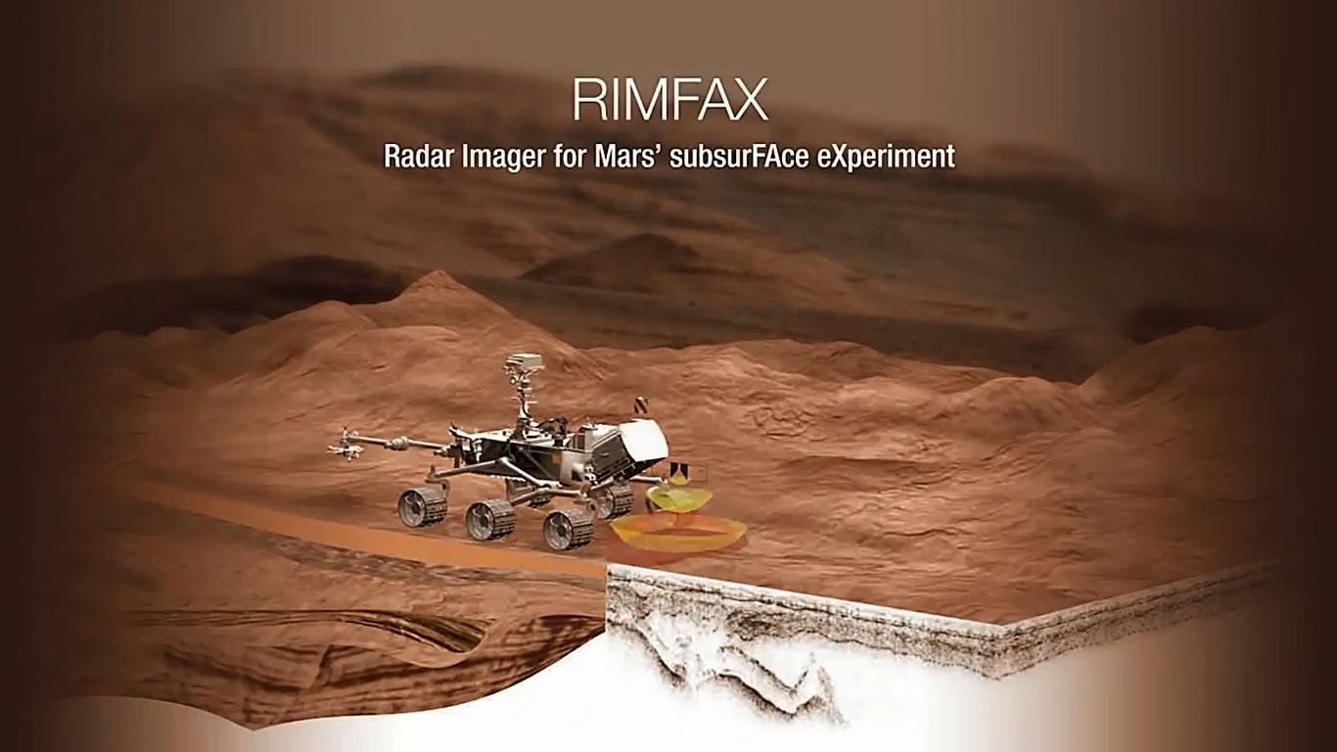
PI Svein-Erik Hamran, Norway
- discover and map sub-surface geologic structure down to 500 m depth with ground-
penetrating radar

Slide 12
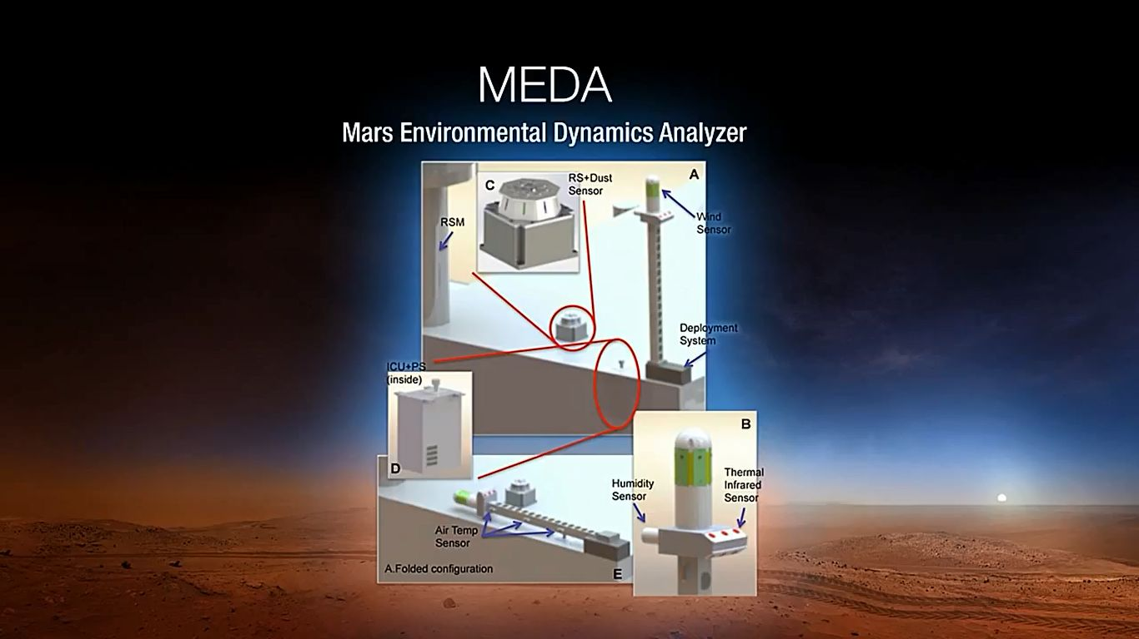
PI Jose Rodriguez Manfredi, CAB Madrid, Spain
- temperature, humidity, wind, dust analyzer with strong Mars mission heritage

Slide 13
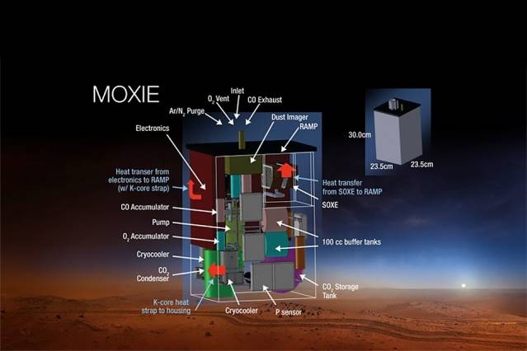
Mars Oxygen ISRU Experiment
PI Michael Hecht, MIT with JPL build
-convert CO2 to O2 as possible future resource (oxidant);
Human Exploration and Operations Directorate contribution

Slide 14
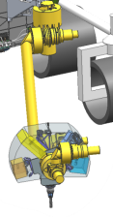
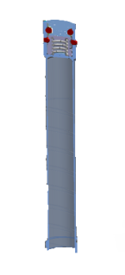
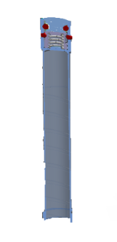
Returned Sample Science Lead: David Beaty (JPL)
Step 1: Intensive study of region of interest with in-situ instruments,
including of abraded surfaces for maximum science return
Step 2: Sample site selection, drilling, caching
1) Rover would drill a core of pencil-like
thickness, 5 cm long, directly
into a clean tube
cache
2) Tube would be hermetically
sealed
3) Sealed tube would be cached
Note: core not visible to science instruments; no proxy core capability but will
have science access to both drill hole and tailings

Slide 15
New Sample Caching Approach: Adaptable Cache
What:
- rather than fill a single container and place it on the ground when
it is adequately full, the new Mars 2020 plan is to place individual
samples or groups of samples on the surface for possible future pick-up
Why:
- improves potential science return
- improves the evolution of mission risk as the number of samples increases
- across Mars 2020 and possible return mission, reduces engineering complexity
After detailed study of science and engineering considerations, MPO recommended, and
NASA HQ approved, the adaptable cache. This approach is now the Mars 2020 baseline.

Slide 16
Possible Mars 2020 Caching Scenarios
1: Full Cache
2: Minimum Mission Success Cache
Segmented or Redundant Cache(s)
NOT VIABLE
Full container, 31 samples
Partly full container, ~20 samples
Six word descriptor goes here
Redundant caches (from DS)
3: Hybrid Cache
4: Adaptable Cache
A
B
Small container + groups of singles
Groups of singles
Six word descriptor goes here
Isolated single samples

Slide 17
Cache Risk Evolution
Risk level where operations
start to be affected
1. Full Cache
Risk- aversion
All scenarios before
“mission success” cache
3-4a. hybrid OR adaptable
2. MMS Cache
4b. adaptable
mission progression ≈ science value of sample collection
“mission success”
cache drop
final sample/
cache drop

Slide 18
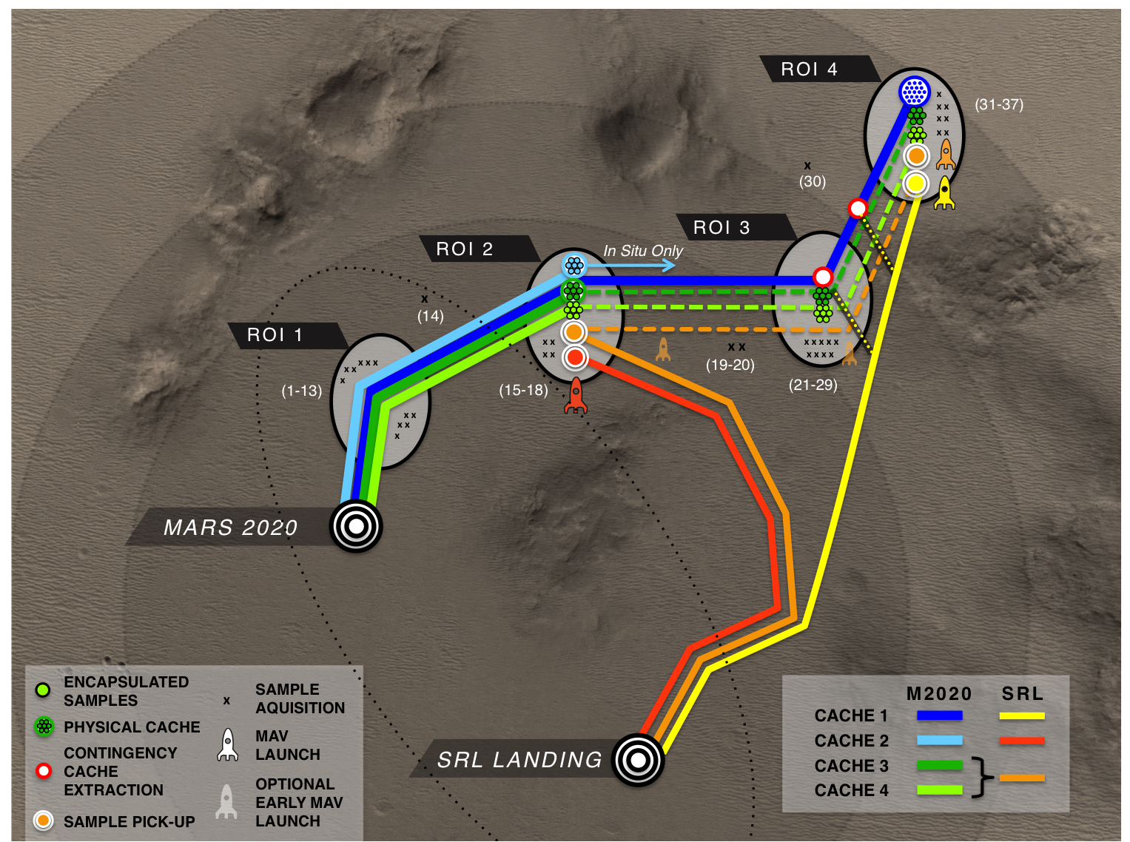
Traverse & Sampling Scenarios

Slide 19
Pros and Cons of Adaptable Cache
Pros:
Cache risk minimized, so would not dominate rover operations
All tubes on board rover could be filled and made available for possible return
“Best” samples for return could be identified when all science data is fully digested
No need to return inferior samples with “best” samples.
Caching system somewhat simpler for Mars 2020
Retrieval mission need not deal with “dead” Mars 2020 rover
Cons:
Maximum temperature of samples may be increased above desired science goal
Greater traverse potentially required for retrieval mission
Retrieval mission must be able to locate and transfer tubes from surface into MAV

Slide 20
Mars 2020 Second Landing Site Workshop (LSW2)
- Mars 2020 science team is working to understand how science observations will
meet science objectives, and how both science objectives and capabilities are affected
by landing site selection. This will be a focus of the second Mars 2020 Project Science
Group meeting next month, and will help inform LSW2.
- further discussion of LSW2 later in the meeting.

Slide 21
Mars 2020 Project Update:
Capabilities
Turret Imager. Project studied options and recommended inclusion to NASA HQ.
- will serve science, engineering, and outreach objectives
Engineering Cameras. New design with color and higher resolution to replace
MSL navcam/hazcams
3. Three New EDL Cameras. Rover-mounted looking at descent stage; descent stage-mounted
looking at rover; backshell-mounted looking at cruise stage/parachute.
Terrain Relative Navigation during EDL. Recommended to NASA HQ.
Nuclear Power Source. NEPA process completed, nuclear power source approved.

Slide 22
Mars 2020 Project Update:
Challenges
1. Planetary Protection. Current intensive focus on requirements definition with
Planetary Protection Office.
2. Operational Efficiency. Many enhancements under consideration to ensure that all
science objectives can be met in nominal mission.

